Slide 1
Chocolate Power
The most powerful chocolate ever

Slide 2
Ingredients
Milk Chocolate
Cookies and Cream
Chocolate chips
Marshmallow

Slide 3
Candy Creation Description Chocolate Power
Chocolate power is the most powerful chocolate ever made. It is chewy and a bit nutty. You will love this yummy treat that will take your taste buds on a wild ride. Even professional wrestlers will love this powerful treat. Chocolate power will melt in your mouth, and you will love it. It contains very popular chocolate. You have looking for chocolate power your whole life.

Slide 4
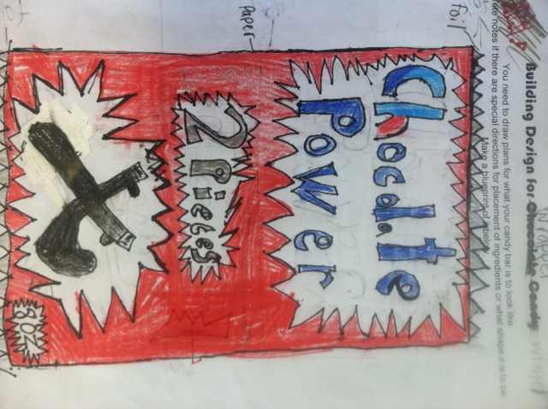
Wrapper Design

