Slide 1
Inside-out S’more
by:jaycie ward

Slide 2
About the inside-out s’more.
The cost of this chocolate bar is 1.50 each. For a limited time only, they are buy one get one free! This yummy treat is going to make your life easier because no fire is needed!

Slide 3
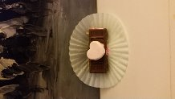
Ingredients: Fun size milk Chocolate bars, Pink Food coloring, Graham Crackers, Fluff, and a heart marshmallow.

Slide 4
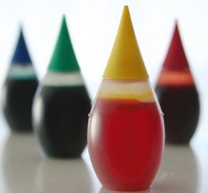
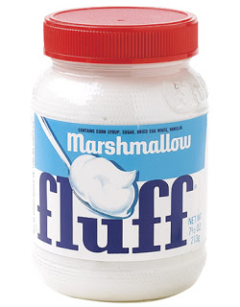
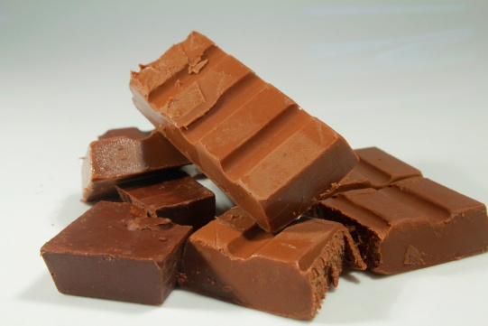
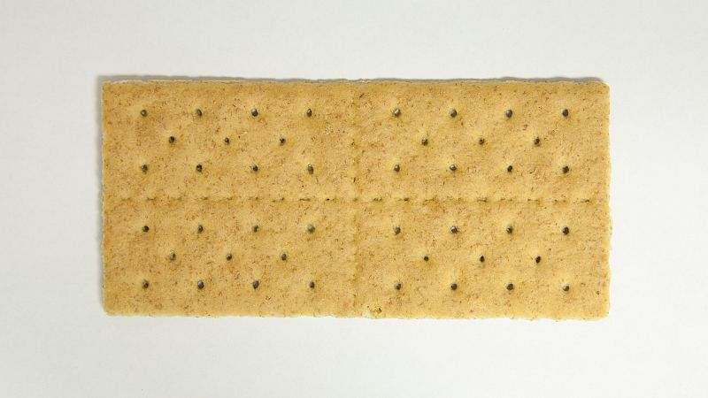
Step by Step instructions on how to make inside-out s’mores
~First you mix the fluff and the pink food coloring in a glass bowl.
~Then, using a gallon size zip lock bag, crumble the graham crackers and place in a separate bowl.
~Next you will need to spread the pink fluff on your fun size chocolate bar.
~Now you need to put your chocolate bar (fluff side down) into the graham cracker crumbles.
~Place another fun size chocolate bar on top of the graham cracker crumble to make a sandwich.
~Finally, using a small amount of fluff, decorate by placing your heart shaped marshmallow on top.

Slide 5
This chocolate bar is sure to make your life easier.
Do you ever wish that you could enjoy a S’more but can’t get outside to make a campfire? Well now you can!! Introducing the Inside-Out S’more, the S’more with a twist. The Inside-Out S’more is a smooth, gooey, milk chocolate on the outside, crunchy graham cracker and pink fluff on the inside, topped with a little heart shaped marshmallow. Mouth watering Inside-Out S’mores available in stores now!!

Slide 6
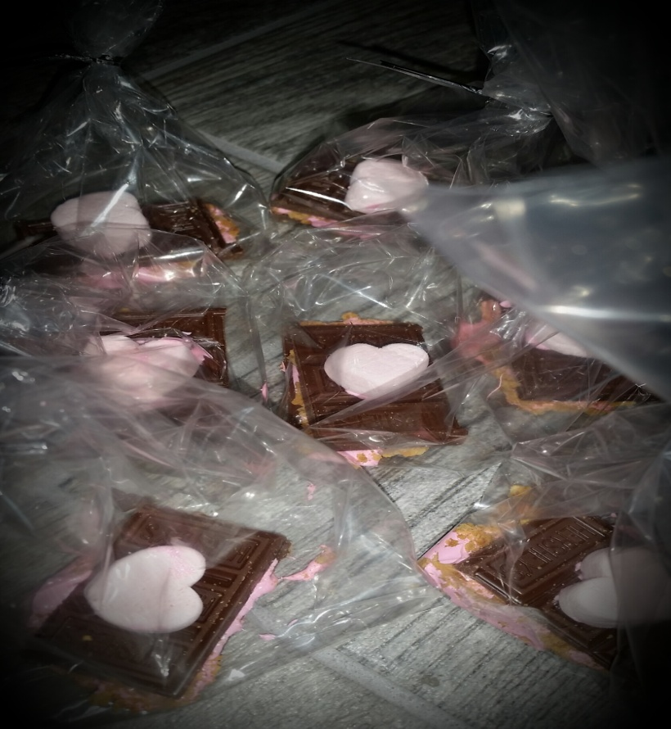
your final product…

