Slide 1
NUTTY DELIGHT

Slide 2
NUTTY DELIGHT
Nutty Delight is very delicious. It will be the best candy bar you have ever tasted. It is a sweet treat for you and everyone else. It is a very sweet, crunchy, cream, and nutty. It will melt in your mouth. You will love and enjoy every single bite. It taste like a turtle. Nutty Delight is the right candy bar for you. You should try it. It is only $1.00.

Slide 3
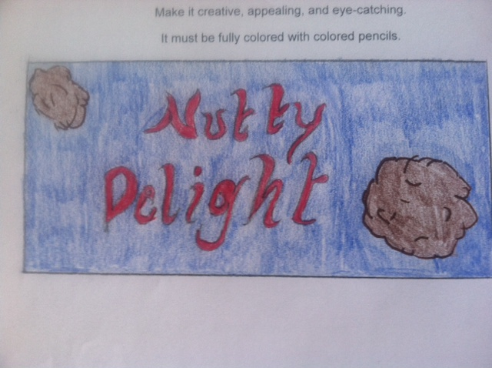

Slide 4
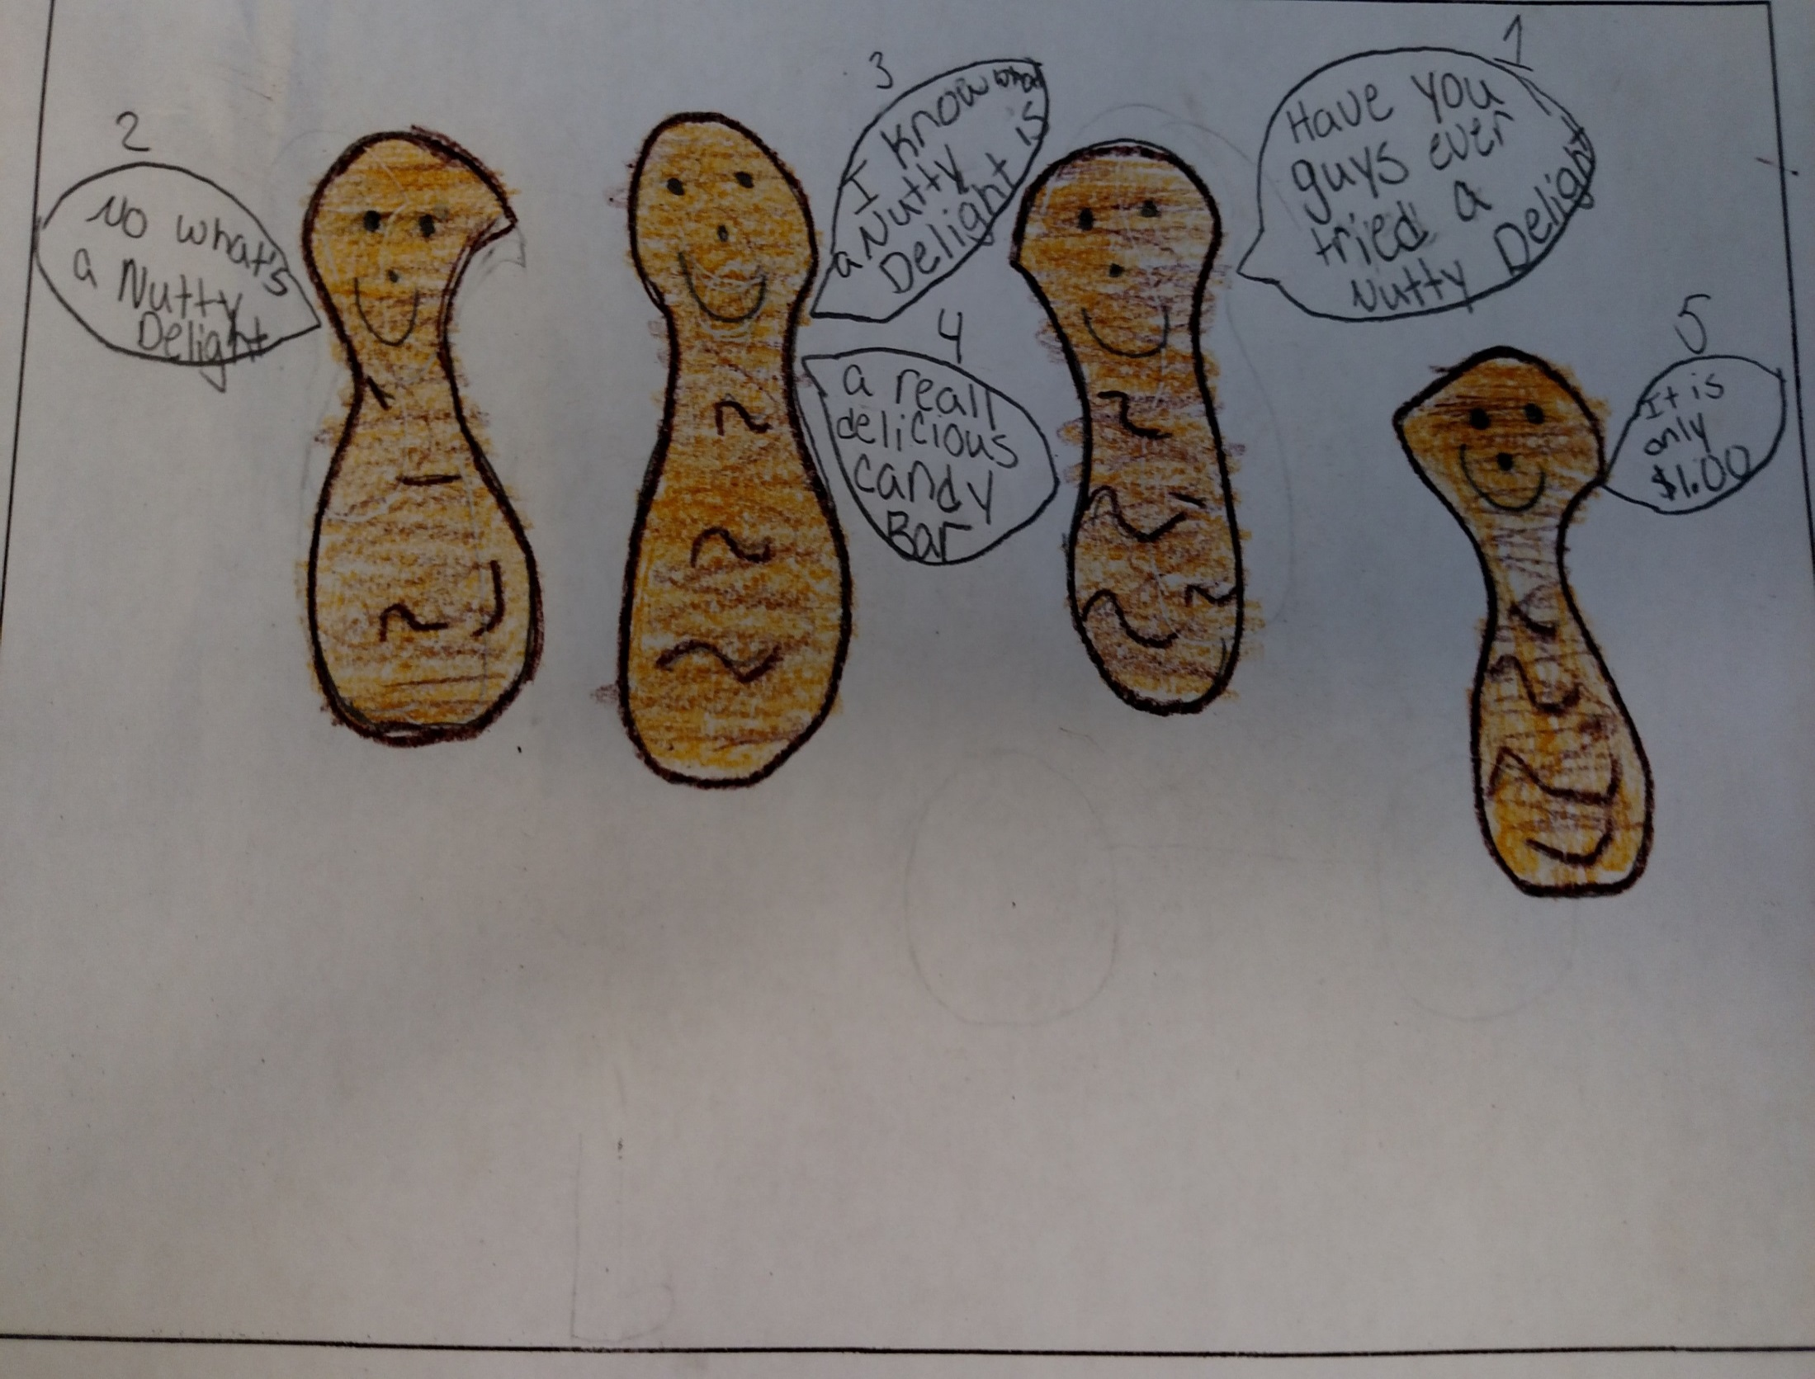
Nutty Delight is the right candy bar for you.

Slide 5
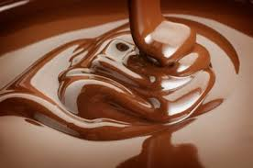
MILK CHOCOLATE

Slide 6
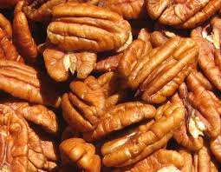
PECANS

Slide 7
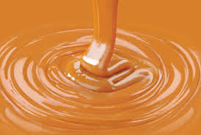
CARAMEL

