Slide 1
Cherry Surprise
By: Katie Morrison

Slide 2
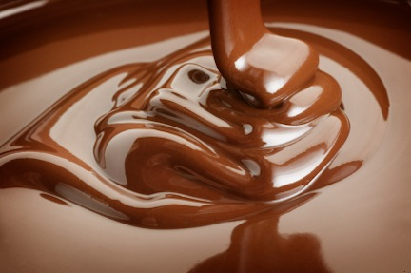
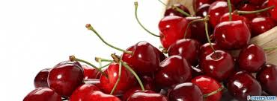
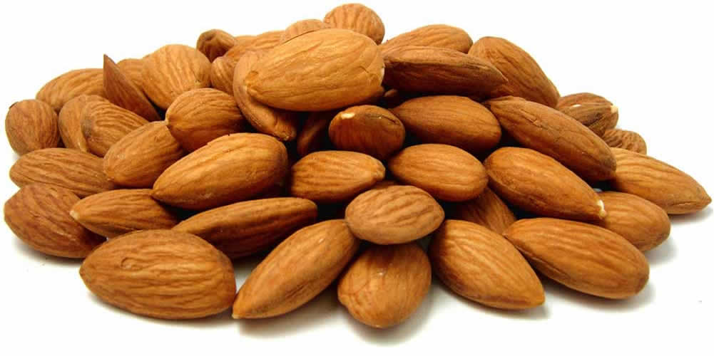
Ingredients include
Milk Choclate
Almonds
Cherries

Slide 3
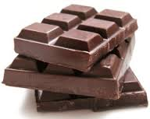
Cherry Surprise is $1.05 and it weighs 3 ounces. If you buy one Cherry Surprise now you can get another one free. But this offer is only for limited time so buy Cherry Surprise now.

